Slide 1
Start-up for 5/1/14
You will watch a video about community interactions of ants. As you watch the video think about the following: Based on what you saw, what do you believe symbiosis is? Which organisms depended on each other? Why did they depend on each other?
http://www.youtube.com/watch?v=RH3KYBMpxOU

Slide 2
4-2 What shapes an ecosystem? Pages 90-97
Objectives: Students will
A) Identify biotic and abiotic factors in an ecosystem
B) Review 4 terms related to ecosystems.
C) Define niche and Describe your Niche.
D) List the three types of community interactions and relate them to something familiar.
E) Summarize the three symbiotic relationships
F) Compare primary and secondary succession

Slide 3
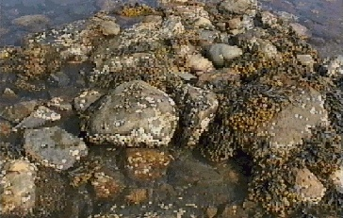
Community Interactions

Slide 4
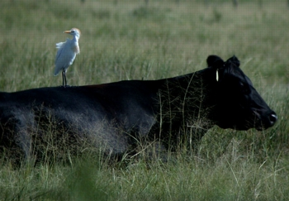
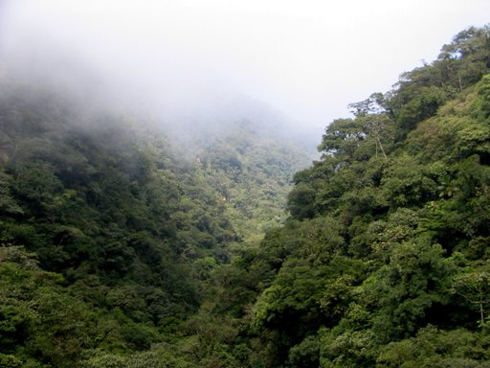
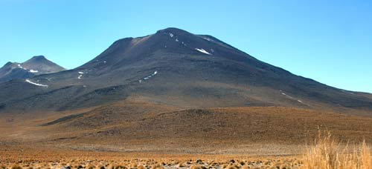
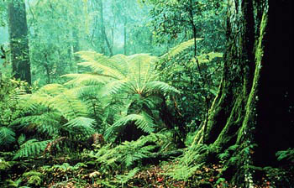
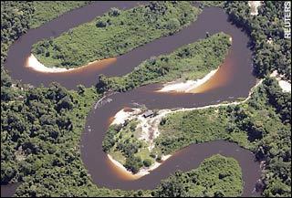
Biotic factors – living organisms Abiotic – non living organisms
Obj. A) Identify biotic and abiotic factors in an ecosystem
Label the above as biotic or abiotic. Why are they?

Slide 5
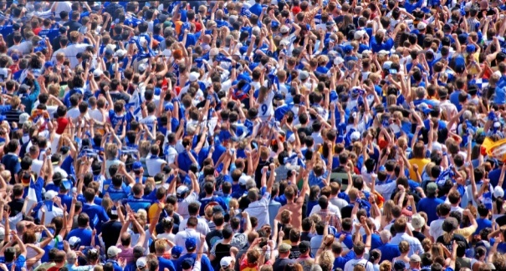
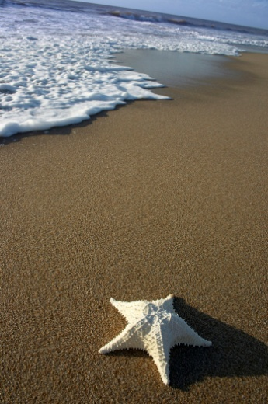
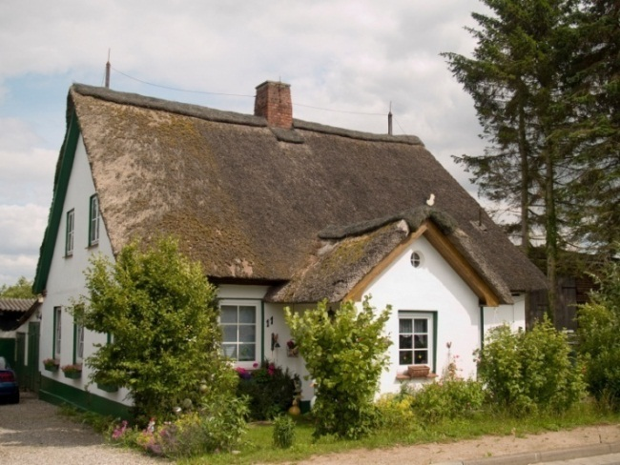
Obj. B) Review 4 terms related to ecosystems.
Vocabulary Review:
A community =
Interacting populations
Organisms and their nonliving environment
An ecosystem =
A habitat =
where an organism lives.
Organism’s habitat, way of life, and physical environment.
A niche =

Slide 6
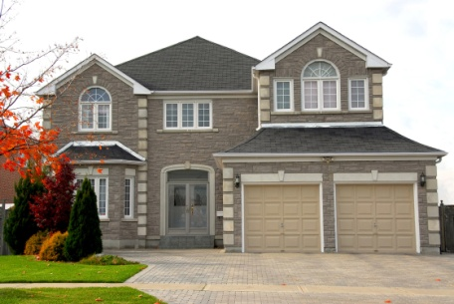
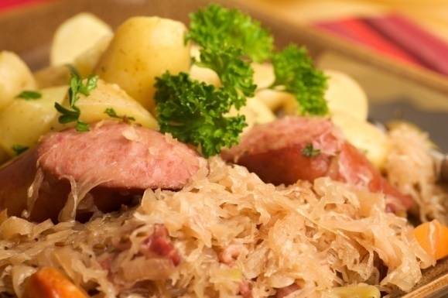
Obj. C) Define niche and Describe your Niche.
This encompasses all the aspects of an organism’s way of life. It includes:
the physical home or habitat
all the physical factors like temperature, pH, type of soil, etc.
how the organism obtains its energy
its predators, prey and interactions with other organisms.
It is the organism’s job
What is your niche?

Slide 7
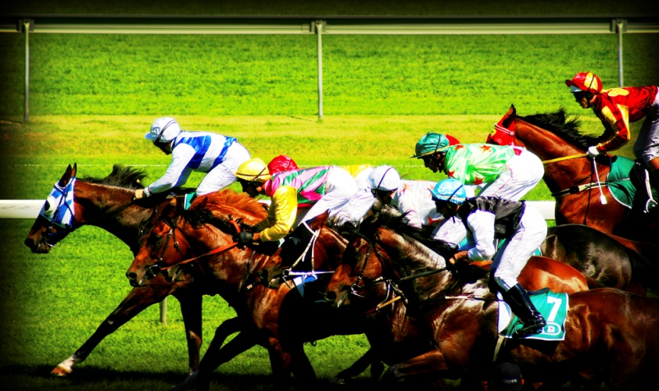
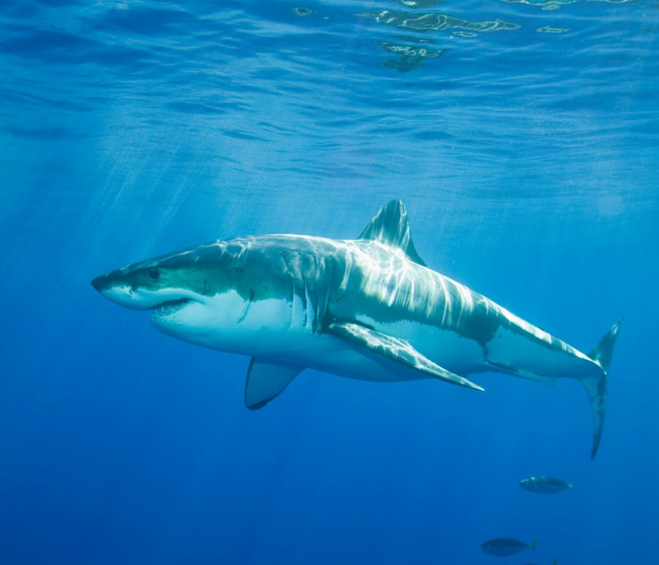
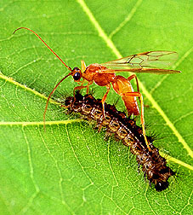
D) List the three types of community interactions and relate them to something familiar.
1. Competition
2. Predation
3. Symbiosis

Slide 8
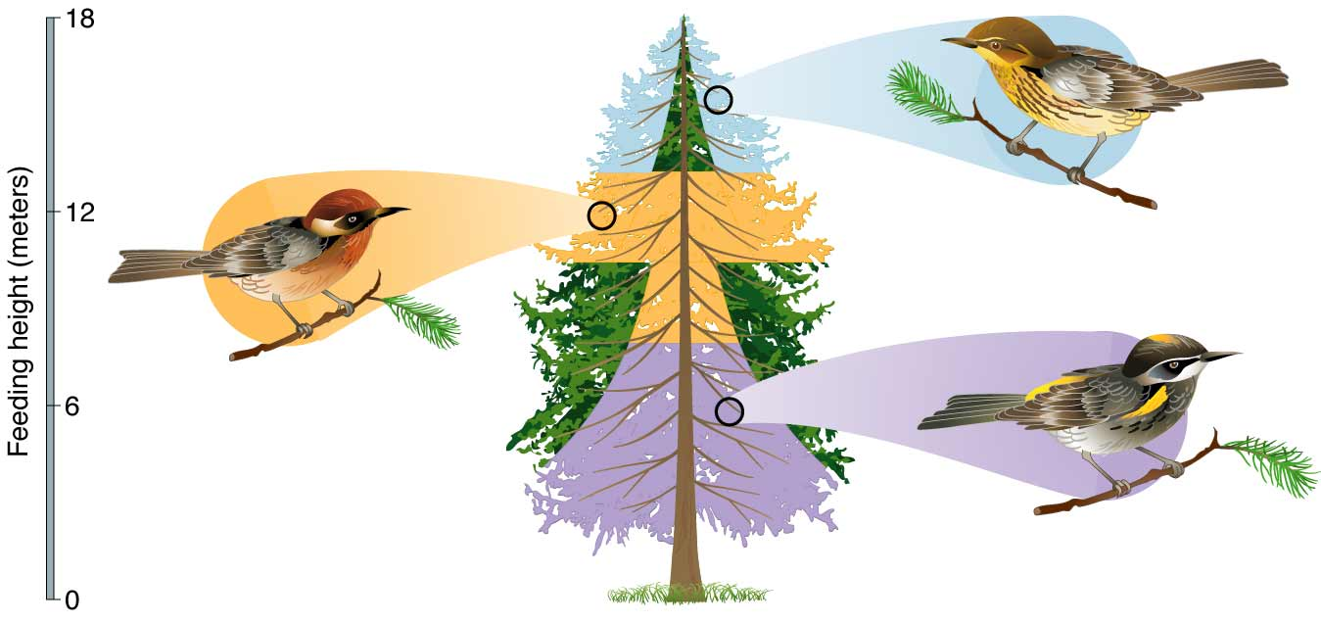
D) List the three types of community interactions and relate them to something familiar.
Community Interaction #1 = Competition
When populations interact, they influence each other’s ability to survive and reproduce.
They are agents of Natural Selection = competition.
No two species occupy the exact same niche.
Competitive exclusion principle = two species with the same niche will compete until one species is killed off.

Slide 9
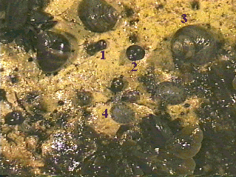
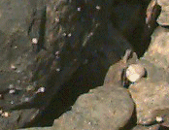
Seashore Gastropod Competition
Snails of the intertidal zone will eat algae. Niches overlap but they are never the same. Rough periwinkles are able to live high in the “splash zone” avoiding direct competition with common periwinkles and predation by crabs.
Both periwinkles can be observed in the same location --------------->
Common periwinkles prefer the lower portions of the seashore.

Slide 10
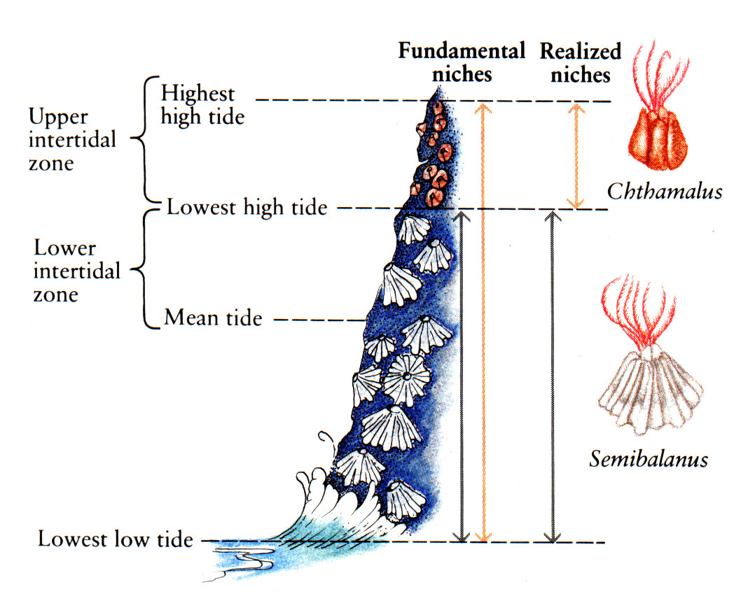
Barnacle Competition

Slide 11
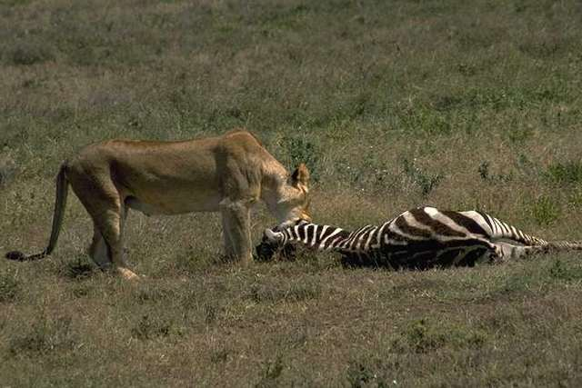
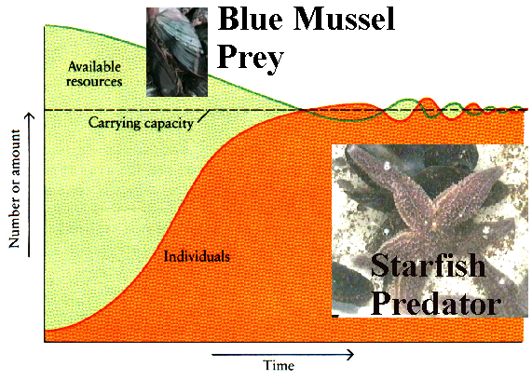
Interaction #2 Predation
D) List the three types of community interactions and relate them to something familiar.
One organism captures and feeds on another
Cyclical trend = When predators get too numerous, prey population drops and predator resources are thus depleted
When prey get too numerous, disease and other density-dependent factors decrease the population
During the population drops, least fit individuals will die.
A change in the prey population leads to evolution in the predator population and vice versa.
Carrying capacity = max individuals supported in environment

Slide 12
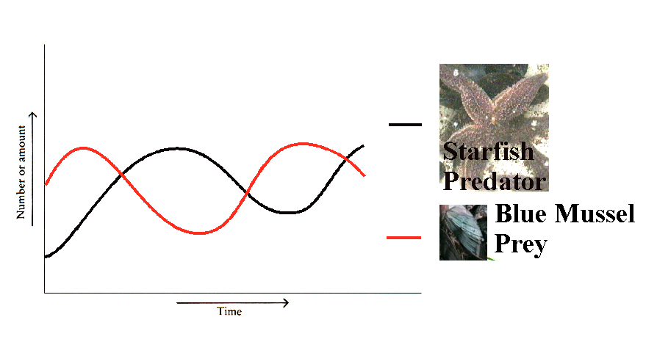
Predator-Prey population trends
Prey and predator populations both follow cyclical trends. Note that the predator lags behind the prey then overshoots, causing its population to crash.

Slide 13
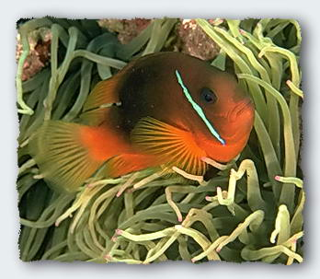
Interaction #3 – Symbiosis
D) List the three types of community interactions and relate them to something familiar.
Symbiosis is a close relationship between different species.
E) Summarize the three symbiotic relationships
Symbiosis (“living together”)
Parasitism (one wins, one loses)
Predator much smaller than prey
Mutualism (everybody wins)
Partnerships with other species
Commensalism (at least somebody wins…)
One species gains, the other not affected

Slide 14
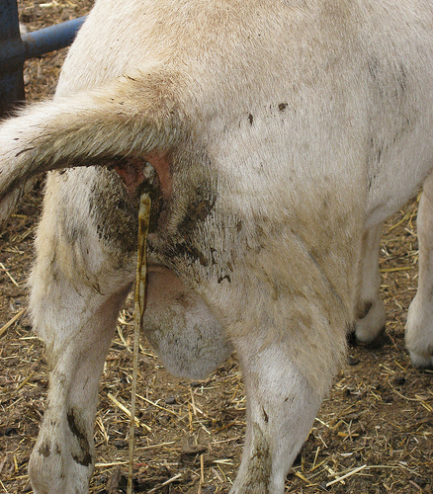
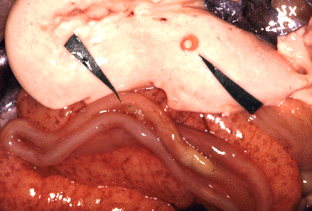
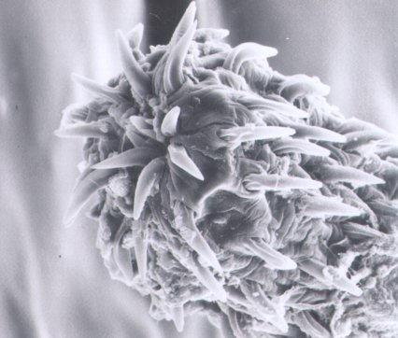
Parasitism
E) Summarize the three symbiotic relationships
Parasitism is a symbiotic relationship in which one organism benefits by feeding on the other. Examples:
Nematodes in cod fish
tape worms on salmonids
tapeworm passing through a goat

Slide 15
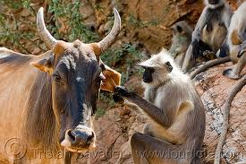
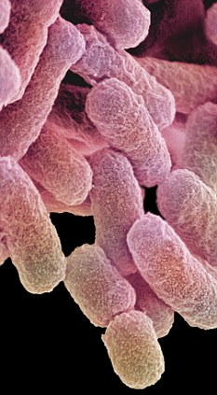
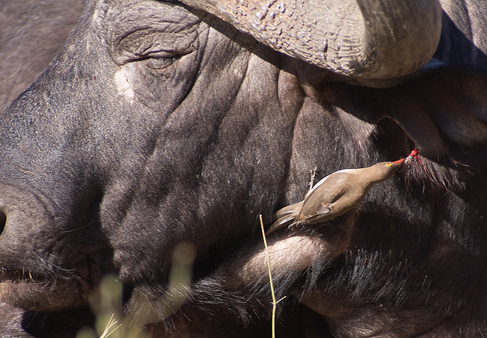
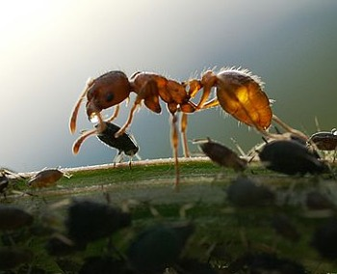
Mutualism
E) Summarize the three symbiotic relationships
Mutualism is a symbiotic relationship in which both species benefit.
Bacteria in our gut
Birds removing parasites from ears and skin
Aphids producing food for ant protection
In fact, almost every known organism has some mutualistic relationship with at least one other organism...
Notes:
Aphids and ants – aphids create sugary substance and ants protect from predators.

Slide 16
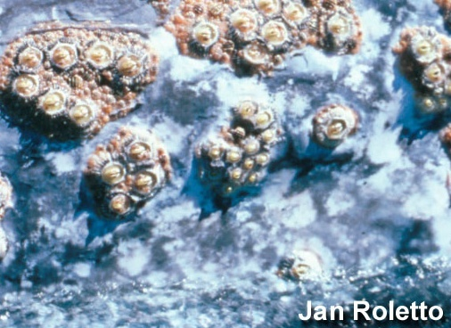
E) Summarize the three symbiotic relationships
Commensalism
Commensalism is a symbiotic relationship in which one organism benefits while the other is not harmed.
Newfoundland Example:
Barnacles on Whale Skin

Slide 17
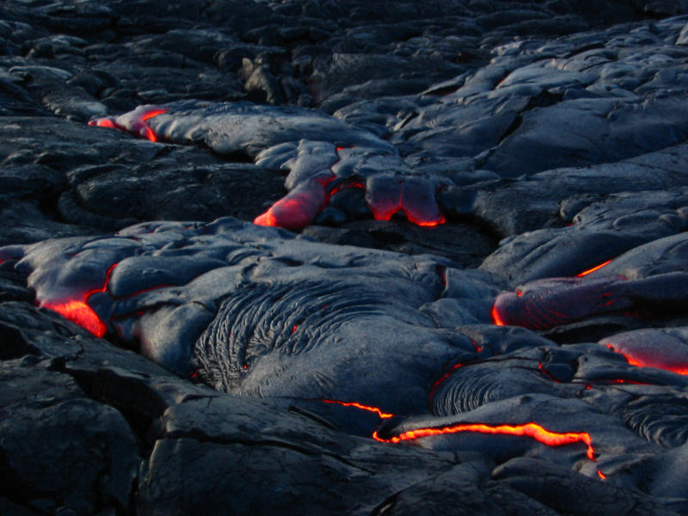
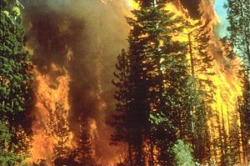
Succession – change in a community
Obj F) Compare primary and secondary succession
Primary Secondary
No soil Soil present
2. Bare rock/ lava Wildfires/cleared land
Pioneer species – first to inhabit an area
Lichens – algae and fungi
Break down rock to form soil
Notes:
Symbiotic relationship of two organisms.

Slide 18
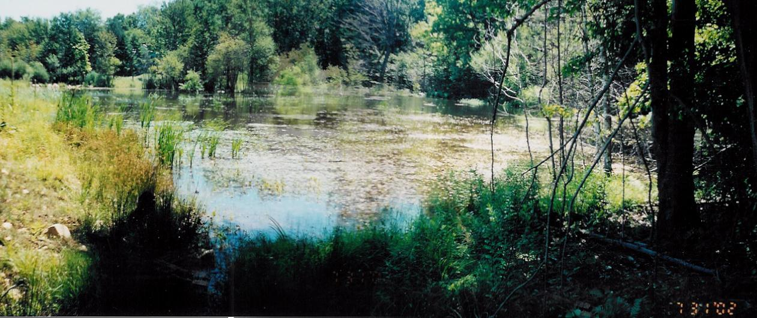
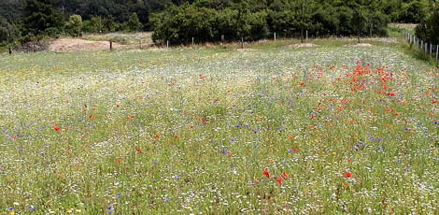
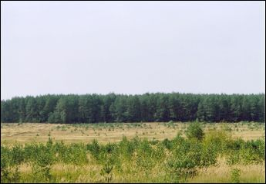
Meadow Succession Lake → Meadow → Forest

Slide 19
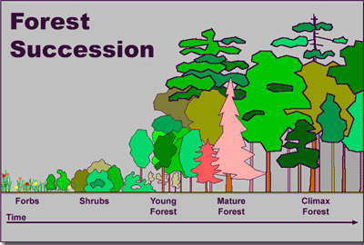

Slide 20
Understanding Check
1. What is a niche?
2. List and define the three types of community interactions.
3. What is succession?
4. What is the difference between primary and secondary succession?

Slide 21
Assignment
CH 4-2 Review Q’s
Pg. 97 #1-5
Do not write down the question
Answer each question using complete sentences.
CH 4-2 Link Words Due (Red Tray)

