Slide 1
Start-up for Tuesday, February 5, 2013
What is a gene pool?
Given the following gene pool for eye color, calculate the allele frequencies: BB BB Bb bb bb bb Bb Bb BB bb Bb Bb BB BB bb bb Bb BB bb Bb
Identify the two causes of genetic variation.
If our environment changed in which light colored eyes were unprotected from the sun’s radiation and caused blindness, predict what would happen to the allele frequencies that you calculated from number 2. B = Brown and green and b = blue
B = 19/40 = 47.5%
b = 21/40 = 52.5%

Slide 2

Chapter 16-2, Pages 397-399
Evolution as Genetic Change
Students will
Summarize how natural selection affects single gene traits.
List and summarize the three ways natural selection affects polygenic traits
Define genetic drift, identify 2 ways it occurs, and summarize how it affects biodiversity.
List 5 conditions required to maintain genetic equilibrium.

Slide 3
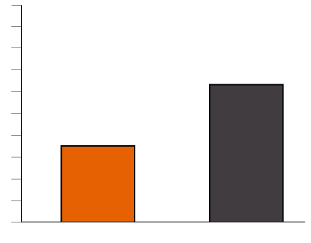
A) Summarize how natural selection affects single gene traits.
If a grassland developed into a forest over a hundred years, predict the change to this lizard population.
Allele frequencies change
Allele can possibly disappear from population
Frequency of Phenotype
(%)
Red Lizards
Black Lizards

Slide 4
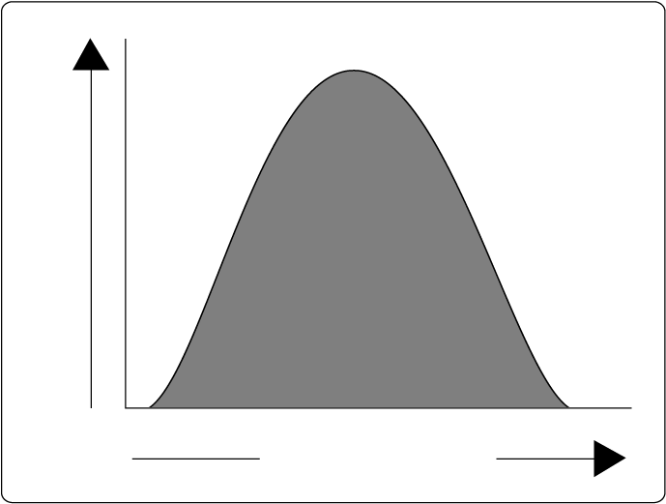
B) List and summarize the three ways natural selection affects polygenic traits
Polygenic = trait controlled by many genes
3 Types of selection
1) Directional
2) Disruptive
3) Stabilizing
Hair color, beak size, skin color, birth weight = many phenotypes

Slide 5
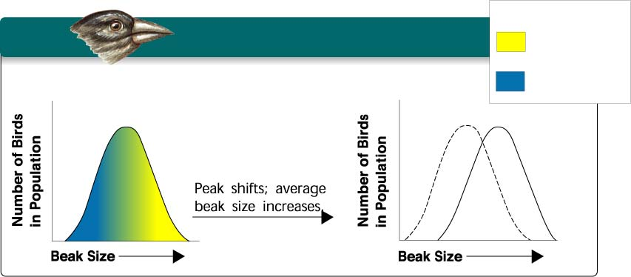
B) List and summarize the three ways natural selection affects polygenic traits
Directional Selection
Individuals at one end= higher fitness
Shifts curve to the left or Shifts curve to the right
Example: Which type of beak would survive best if food became scarce?
Low Mortality, High Fitness
High Mortality, Low Fitness

Slide 6
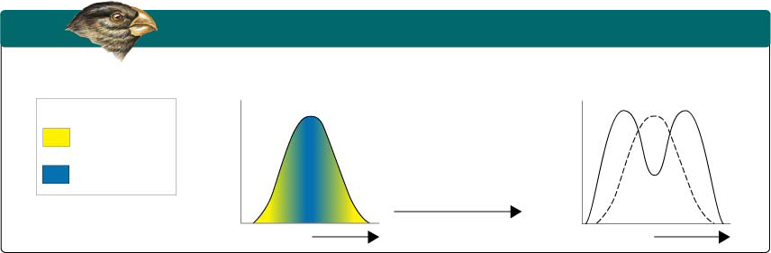
B) List and summarize the three ways natural selection affects polygenic traits
Disruptive Selection
Individuals at both ends = higher fitness
Shifts curve to the left and right, creates camel top look
Example: Which type of beak would survive best if food available included small and large seeds?
High Mortality, Low Fitness
Population splits into two subgroups specializing in different seeds.
Low Mortality, High Fitness
High Mortality, Low Fitness

Slide 7
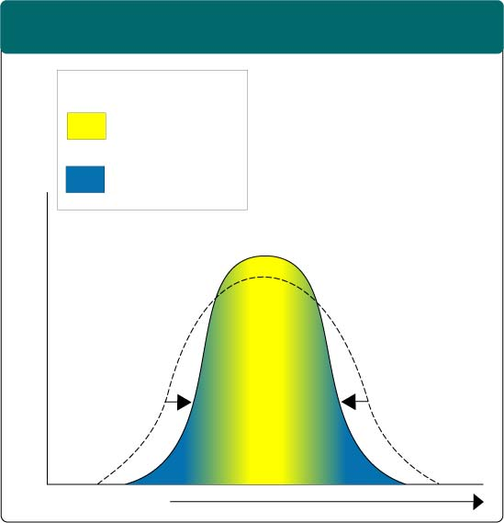
B) List and summarize the three ways natural selection affects polygenic traits
Stabilizing Selection
Individuals in the middle (norm) = higher fitness
Shifts curve to the middle = narrows the peak
Low Mortality, High Fitness
High Mortality, Low Fitness
Example: What would happen to the graph if every baby born this year weighed 6-8 pounds?

Slide 8
Identify the type of selection for polygenic traits, given the scenario for a year.
For birth weight, all babies born weigh below 5 pounds
For height, everyone is less than 4 ft or taller than 6 ft
For tests, everyone scores 60-70%%
For beaks, fish are the only food
Directional to the left
Disruptive
Stabilizing
Directional to the right

Slide 9
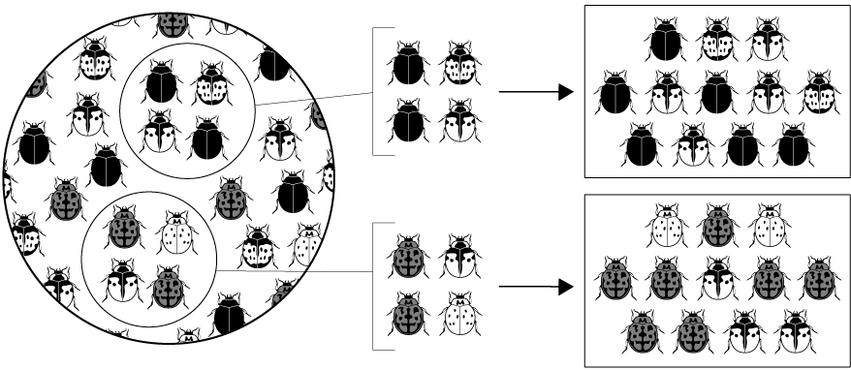
C) Define genetic drift, identify 2 ways it occurs, and summarize how it affects biodiversity.
What is genetic drift?
Random change in allele frequencies
How does it happen?
  1) Founder effect (refer to picture)
  2) Individuals leaving more descendants than others
  How does it affect population diversity?
  Decreases it, less variation
Founding Population A
Descendants
Founding Population B
Sample of
Original Population

Slide 10
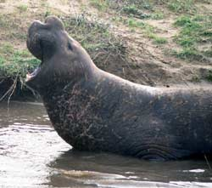
C) Define genetic drift, identify 2 ways it occurs, and summarize how it affects biodiversity.
What happens to the size of a bottle from the bottom to the top?
What do you think a population bottleneck is?
Decrease in population size for at least 1 generation
How does it happen?
  1) Founder effect
  2) Human Hunting to near extinction
  How does it affect population diversity?
  Decreases it, less variation
  An example of a bottleneck:
  Northern elephant seals have reduced genetic variation probably because of a population bottleneck humans inflicted on them in the 1890s. Reduced to about 20 by 1900, now over 30,000 exist. They still bear the marks with less diversity.

Slide 11

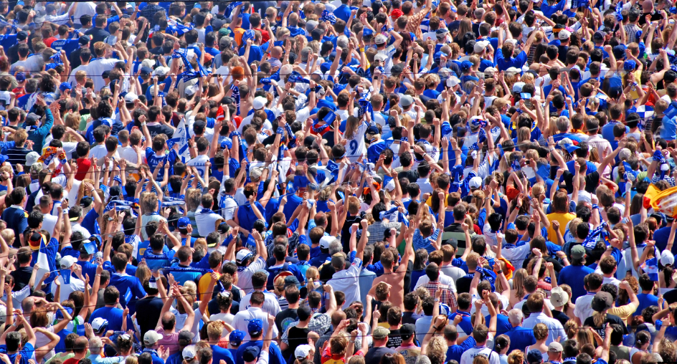
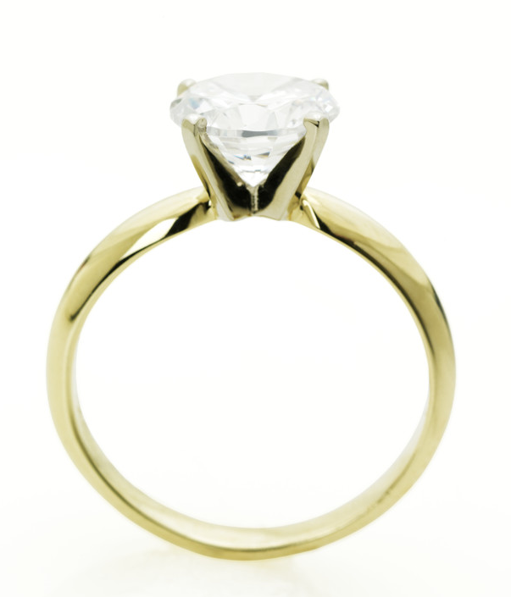
D) List 5 conditions required to maintain genetic equilibrium.
How are allele frequencies kept constant = Genetic Equilibrium?
Hardy-Weinberg Principle = 5 conditions
1. Large Population
2. Random Mating = no exclusive relations
3. No movement in or out of population
4. No mutations
5. No natural selection
Is this possible?
Probably Not

Slide 12
Understanding Check
1. Why does natural selection act on phenotype instead of genotype?
2. List three ways that natural selection can affect polygenic traits.
3. How does genetic drift affect biodiversity?
4. What are two causes of genetic drift?
5. List three of the five conditions required to maintain genetic equilibrium.

