Slide 1
Start-up for Monday, January 7, 2013 Watch the following short video titled "Classical versus transgenic Breeding".
In your Start-up section, complete a quick-write addressing the following questions:
What is classical versus transgenic breeding?
How do you feel about genetically modifying organisms?
Why do you feel this way?
Use the ABC format to complete a quick-write now.

Slide 2
Start-up for Wednesday, January 9, 2013
Create as many words as you can at least three letters long off of the following:
GENETIC ENGINEERING

Slide 3
Biology – Chapter 13 Section 1, Page 319-321
Objectives: Students will
A. Define selective breeding and compare the two types.
B. Identify at least three purposes of selective breeding.
C. Identify two ways that genetic variation is increased.
D. Define genetic engineering and transgenic organisms.

Slide 4
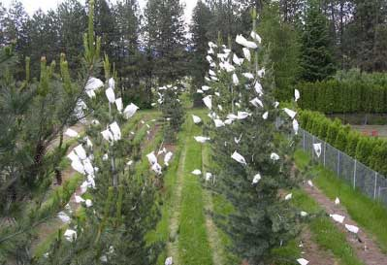
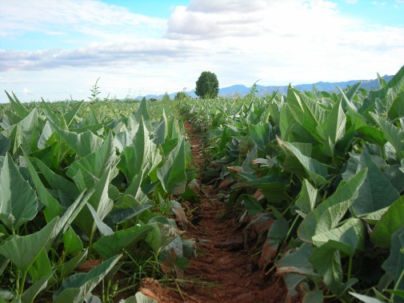
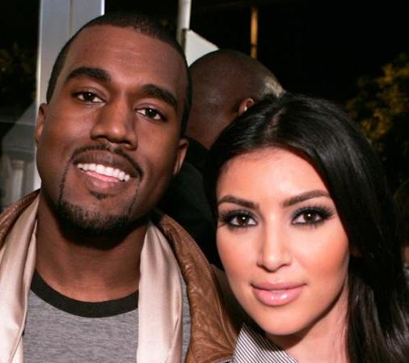
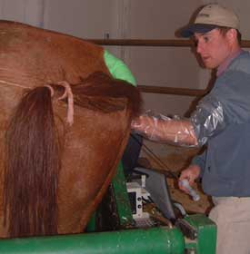
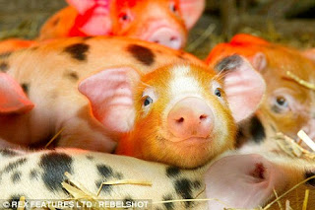
Artificial Selection = Selective Breeding
A. Define selective breeding and compare the two types.
What do you think selective breeding is?
We do it with our plants.
We do it with our animals.
We do it with ourselves.
Humans choose how organisms breed
Look at the differences between the following species of dog:

Slide 5
A. Define selective breeding and compare the two types.
Wild dogs
Terriers
From where did they come?
Viemerana
Collies

Slide 6
A. Define selective breeding and compare the two types.
Over thousands of years man has selected
characteristics in dogs that are useful…..
Very small dogs
Used for pets
Large hunting dogs
Strong & powerful
Large working dogs
Strong and athletic
This is SELECTIVE BREEDING

Slide 7
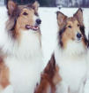
Selective Breeding: Inbreeding vs. Hybridization
A. Define selective breeding and compare the two types.
Mating same species = retains desired traits
Mating different species = combines desired traits
Medium dogs
Friendly
Strong & powerful
+
=
Very small dogs
Used for pets
Large hunting dogs
Strong & powerful
Large working dogs
Strong and athletic
+
=
Which mating is inbreeding and why?
Why is inbreeding potentially bad?
Large working dogs
Strong and athletic
Notes:
Because we learned about hybrids in chapter 11, hybridization will not be a vocab. Word.

Slide 8
Identify each of the following types of selective breeding:
A. Define selective breeding and compare the two types.
1. Tall x short pea plants
2. Dautson x Dautson Dogs
3. Yorkshire x Hampshire Pigs
4. Suffolk x Suffolk Lambs
5. Roma x Roma Tomatoes
6. Mexican x Chinese Human
1. Hybridization
2. Inbreeding
3. Hybridization
4. Inbreeding
5. Inbreeding
6. Hybridization

Slide 9
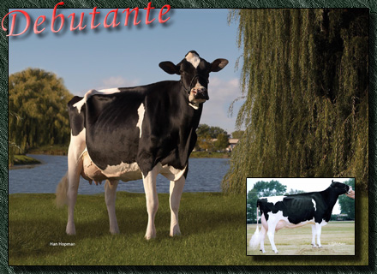
B. Identify at least three purposes of selective breeding.
Why is selective breeding a good thing when it comes to plants and animals?
Artificial selection (selective breeding) =
Breed improvement of animals and plants, for man’s benefit.
1) More milk = More food
2) Structural correctness = lives longer

Slide 10
B. Identify at least three purposes of selective breeding.
This artificial selection of
characteristics happens in plants as well..
In the wild there are various species of corn plant

Slide 11
B. Identify at least three purposes of selective breeding.
Good point: Strong stem
1
Bad point: Small root
Bad point: Small head
2
Good point: strong roots
Good point: Huge head of grain
3
Bad point: Small plant
Bad point: Drought sensitive
4
Good point: Disease resistant
Notes:
Imagine four different species of corn plants, with the following traits.

Slide 12
B. Identify at least three purposes of selective breeding.
Good point: Strong stem
Good point: Disease resistant
Good point: Huge head of grain
Good point: Strong roots
Super CORN!
Longer shelf life
Disease resistance
More Food
Heat, wind and drought tolerance

Slide 13
B. Identify at least three purposes of selective breeding.
Look what has happened to the varieties
of the corn over last few hundred years.

Slide 14
B. Identify at least three purposes of selective breeding.
Look at the variety of plants that have been artificially selected from mustard!

Slide 15
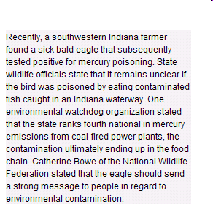
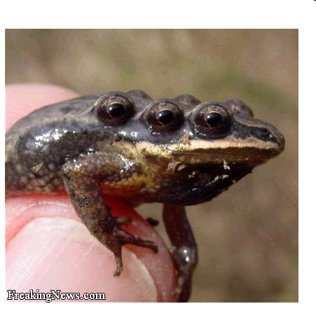
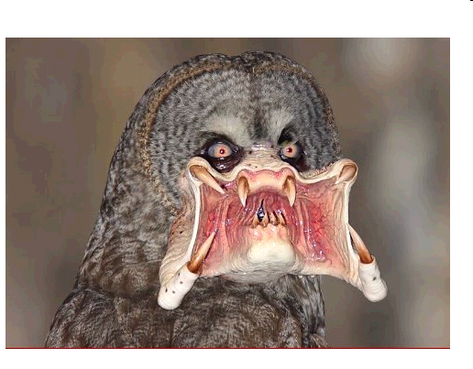
How do scientists increase variation?
C. Identify two ways that genetic variation is increased.
What is ultimately changed?
Mutations through chemicals or radiation

Slide 16
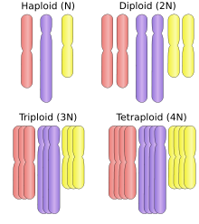
C. Identify two ways that genetic variation is increased.
Polyploidy =
many sets of chromosomes
Induced in plants, not animals
Increases production
Growing lots of different varieties of wheat…………
……looking for new characteristics.
Notes:
Scientists and genetic engineers create test plots with genetically altered plants.

Slide 17
Things I must know about artificial selection/selective breeding
A.S. is the gradual improvement of organisms
characteristics – for humans benefit.
A.S. takes hundreds of years
We have A.S. lots of animals and plants
A.S. animals & plants produce higher yields:
1. more milk
2. more meat
3. more fruit

Slide 18
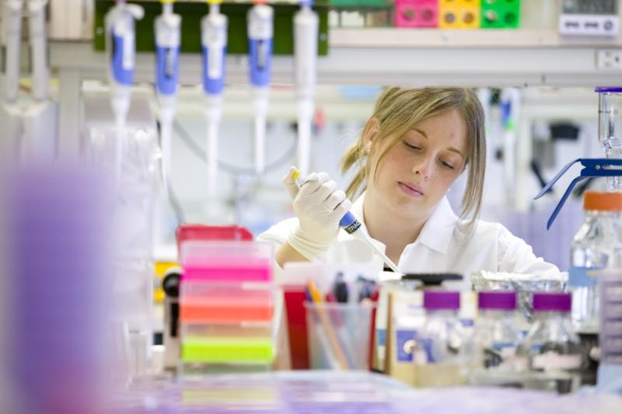
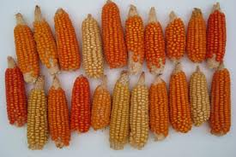
D. Define genetic engineering and transgenic organisms.
What do engineers do to buildings?
Based on this, what do you think genetic engineering is?
It’s the changing of DNA on purpose
Why?
Cures
Specie Improvement
Scientific curiosity

Slide 19
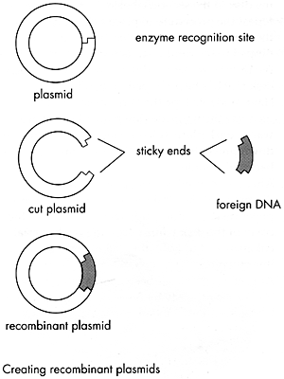
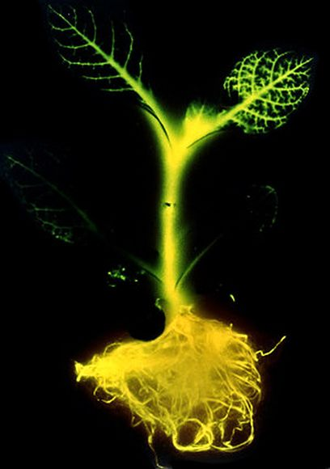
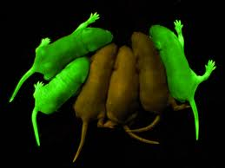
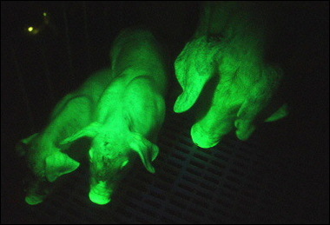
D. Define genetic engineering and transgenic organisms.
What is created?
Transgenic organisms.
What does the pre-fix trans mean?
Trans – across or opposite sides
Transgenic organisms contain genes from different organisms. “Across” different species.
Examples:
How is it done?
Transformation:
Inserting genes from a different organism using a plasmid (circular bacteria)

Slide 20
Exit Ticket
1. Choosing how organisms mate is called what?
2. If you breed a holstein (black and white) to a jersey cow (brown), what type of selection is this?
3. How do scientists increase genetic variation?
4. How are selective breeding and genetic engineering different?
5. How are selective breeding and genetic engineering the same?
Show me these completed and complete your link word. It is due today.

Slide 21
Assignment 2/5/14
Finish :
Exit ticket (Turn in as you leave today)
Link words (Due Today)
Pg. 321 #1-5 and turn in

